Slide 1

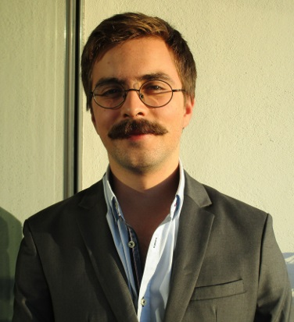














EDUCATION
Bologna Degree in Information Systems and Computer Engineering 2012 – July 2017.
Instituto Superior Técnico Average grade of 13/20.
A-levels
2010 – July 2012
City College Plymouth, UK
Average Grade: B
Subjects: Maths, Physics and Film Studies.
WORK EXPERIENCE
Summer Internee – JULY 2016 – AUGUST 2016
Bridge Robotics – Lisbon
bridgerobotics.com
Worked in frontend development, object-oriented programming in python and javascript, websockets and messaging platforms like RabbitMQ and crossbar.io to test and extend the Bridge Robotics framework.
SKILL / INTERESTS
Frontend Software Developer– September 2016 – Present
opprDev– Lisbon
oppr.io
Oppr is a student created organization whose goal is to find paid work and to share the workload with other like minded students. With opprDev I further developed my frontend programming skills.
HARD SKILLS
JOAQUIM ESTEVES
Date of Birth: 01/09/1993
Nationality: Portuguese
Alameda dos Oceanos nº 95 4ºEsq, Lisboa.
1990 - 213
Portugal
joaquimbve@hotmail.com
+351 91 399 39 37
joaquimesteves.github.io
C
C++
JAVA
SQL
PHP
Python
HTML5/CSS3
JavaScript & JQuery
Languages
Portuguese– Native
English – Full Professional Experience
Spanish – Fluent
French – Basic Use
Driving License B1, B
About Me
I am an adaptable, hard-working graduate seeking an entry-level position in software development, which will utilise the programming and management skills developed through the most renowned computer engineering course available in Portugal.
I’m obsessed with old movies, all types of Latino music and traveling.

